Slide 1
Covid-19 Health and Safety Briefing
Dec 2021

Slide 2
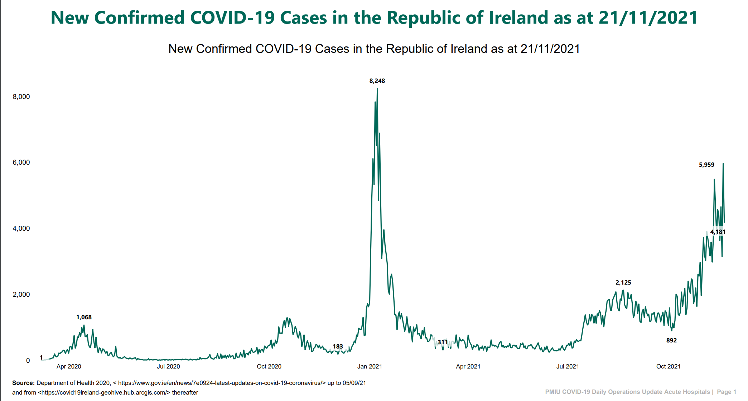
Current position with COVID-19
Case numbers of Covid 19 in Ireland have increased dramatically. They are at the highest level in the pandemic since January 2021. This is a matter of great concern.

Slide 3
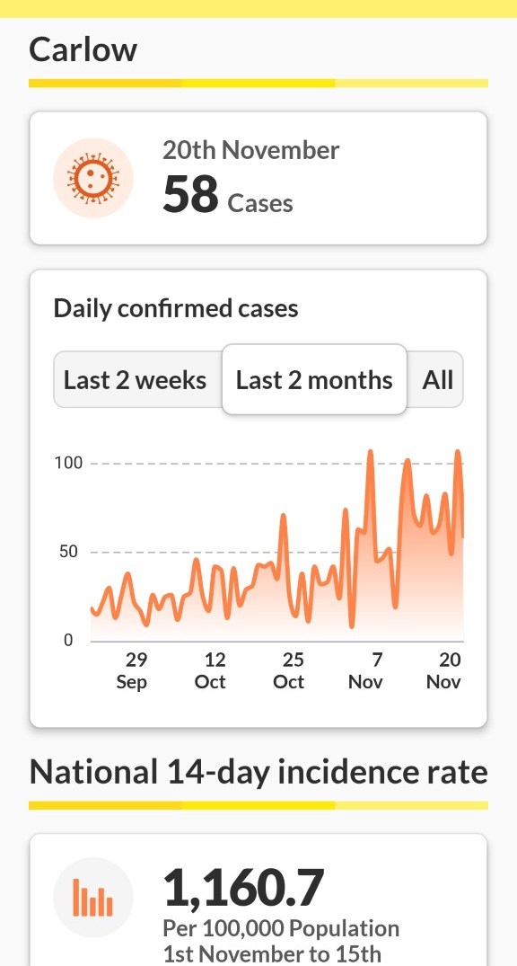
COVID-19 Locally
Vaccines roll out has been quite successful in Ireland with 93% of over 12 year olds being fully vaccinated. As a result hospitalisation are much lower than January last but they are rising also, which is very concerning.
Currently in Carlow approximately 70 people a day are testing positive for Covid 19 and nationally approximately 50 people are dying each week.
Vaccines will stop serious illness but will not fully prevent you catching or transmitting the disease.

Slide 4
Delta Variant of COVID-19
The current Covid 19 Variant is called Delta.
Most cases now in ireland are the Delta variant – symptoms may seem like a common cold.
Delta is 75% more infectious than previous strains.
Vaccinations are reducing risk of infection and serious illness.
NPHET advice: Anyone with
common cold symptoms should get
PCR tested for Covid-19
Last week a new Variant of concern
called Omicron Was detected in
Africa and now in Europe.
but little is certain As of variant yet.
Common Symptoms of COVID-19 Delta Variant include:
Sore throat
Cough
Nasal congestion: Runny nose / blocked nose / blocked sinus
Fever
Headache
Muscle aches and pains
Difficulty breathing
Changes to sense of taste or smell

Slide 5
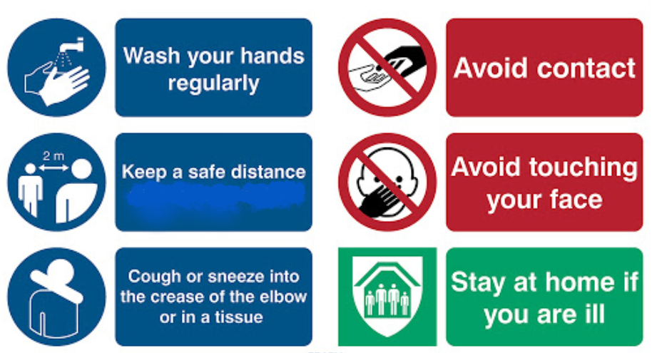
So what can we do to help?
If in school, socialising or at home the precautions that work are still the same

Slide 6
Well done for all your efforts as the school has performing very well so far. We do have some Areas of Concern for students safety. For this reason we need to Redouble our efforts.

Slide 7
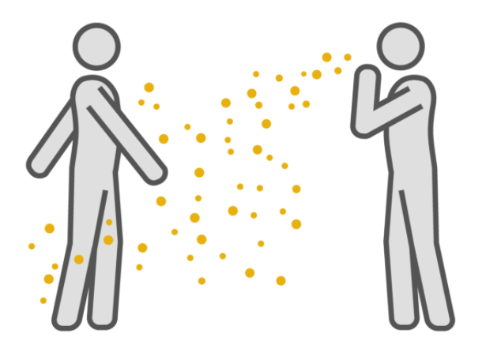
Don’t bring COVID-19 into school.
If you are experiencing COVID-19 or cold like symptoms or are ill in general stay at home and self isolate.
Contact a GP, or go online and get a PCR test.
If you are a household close contact (someone at home has COVID) stay at home also, restrict your movements and take the antigen tests which will be send out by the HSE.
Do not come to school until 2 days after a negative COVID-19 Test and are symptom free.
OUR FIRST PROTECTION IS KEEPING IT OUT!

Slide 8
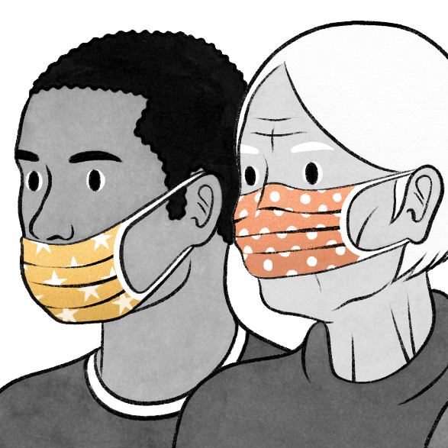
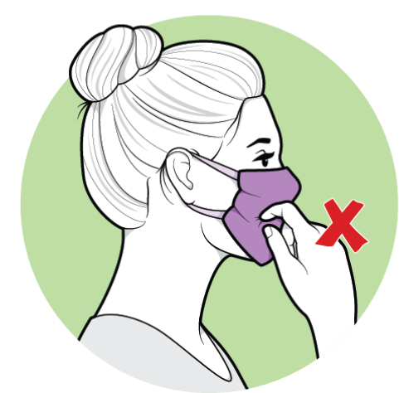
2) Proper use of Face Coverings
A number of students are still being corrected on improper wearing or touching of masks.
A poorly used face covering is useless.
Ensure they are a good fit particularly over your nose (remember the pinch at the nose).
Avoid touching the front (if you are sick your hand can now transmit the virus).
Dispose of single use face coverings carefully.
Sanitise hands after handling face covering.
USE A FACE COVERING AT ALL TIMES INDOORS AND OUTDOORS LESS THAN TWO METERS (UNLESS PLAYING OUTDOOR ACTIVE SPORTS).

Slide 9
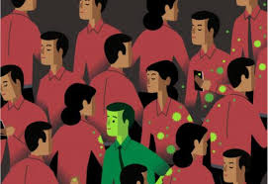
3) Avoid Crowded Areas and Ventilation
Good ventilation and avoiding crowded areas are very important to avoid potential outbreaks in school.
Avoid crowded areas and avoid congregating where possible. Abide by guideline numbers of maximum 3 people in the bathrooms at a time.
School trips and Sports team have returned and school buses are back at full capacity. You cannot remove your mask on buses as you are putting a lot of people at risk. You may be asked to stay in school for the next trip.
Over the Winter the school will get colder with the extra
ventilation, please don’t close window without teachers
permission. Wear extra layers if needed (school jackets,
thermal layers).

Slide 10
4) Social Distancing and Eating
Sanitise/wash hands before eating.
No food to be consumed when walking around indoors.
Maintain two metre distance when eating.
Minimise the time masks are off whilst eating.
All food to be consumed in the lunch hall, marquee, outdoors or available classrooms in your area. If eating in classrooms only every second desk can be used.
No siting on tables, radiators, window sills or at teachers desk.
No eating in Areas.
Sanitise hands on entry to the building.
As a result masks will only be off while sitting down and 2m apart
NO EATING OR DRINKING WHILE MOVING AROUND

Slide 11
Where to Eat and Socialise?
Eat and socialise outdoors, if possible. Otherwise in the designated areas for your Year Group:
All eating should be finished by 1:30
First Year | Second Year | Third Year | Transition Year | Fifth Year | Sixth Year
Lunch Hall, Rooms 20, 21, G1 or G2. | Lunch Hall, Rooms 15, 16, 17. | Rooms 1, 2, 3, 4, 5. | SLOT | Marquee, Rooms 22, 36, 37, 38, 39. | Marquee, Rooms 6, 8, 9, 11, 12.
No eating in the Corridors, Areas, while moving around or Computer Room.

Slide 12
Discipline System –
Covid -19 Slips may be issued by staff if students don’t play their part and protect others.
Safety comes first.
Protect each other – play your part.
The school takes its responsibility to Students and Staff
very seriously.
We cannot let a pupils bad choices become a safety risk
for other students.

Slide 13
Keep playing your part. You are doing a great job so far. Protect yourself, protect your family, protect your friends and protect your school.

